Slide 1







// topic

Slide 2

What is Sports Analytics
Sports analytics is built around a framework that comprises three main elements: data management, predictive models, and information systems. The goal is straightforward: to help decision-makers—from executives to coaches—gain a competitive edge. In practice, data flows through an organization, is processed, and becomes actionable insights. The data management function organizes this raw information, which then feeds into predictive models and information systems. These models can generate standardized results or answer specific questions on demand. Finally, the information system delivers these insights to the decision-makers in a format that’s easy to interpret and act upon.

Slide 3






Visual of sports analytics framework
An equally critical component is leadership. While having robust analytics tools can create a competitive edge, leadership plays a key role in defining an effective analytics strategy. It ensures that the organization fully utilizes its analytics capabilities.

Slide 4
What Are the Goals of Sports Analytics
The primary objectives of sports analytics are twofold. First, it streamlines the decision-making process by centralizing all relevant information for evaluating players, teams, or prospects. By offering a single, integrated platform, it frees decision-makers from the time-consuming task of gathering data from disparate sources, allowing them to focus on analysis.
The second aim is to deliver unique insights to decision-makers. With the growing volume and complexity of available data, extracting valuable information becomes increasingly challenging. Sports analytics models help distill this data into actionable intelligence, offering perspectives that would be unattainable without advanced analysis. This approach enables a more informed decision-making process, often blending statistical forecasts with expert opinions for a comprehensive understanding of a player’s potential.

Slide 5

Why Is Sports Analytics Important
Sports analytics has become an indispensable tool in both the competitive and business aspects of the sports industry. On the field, coaches and managers are leveraging data analytics to inform their decisions, from game strategies to player evaluations and training regimens. Not tapping into this data-driven approach can put teams at a competitive disadvantage.

Slide 6
Why Is Sports Analytics Important
Similarly, on the business side, teams are fighting for fan engagement in an increasingly crowded marketplace filled with numerous entertainment options. Analytics provides valuable insights that help teams optimize financial management and fan engagement. One example is the Boston Red Sox’s use of data to strategically place concession and memorabilia stands, enhancing fan experience and positively impacting revenue.
While building data infrastructure or coding machine learning algorithms may not be required for every sports professional, a basic understanding of the capabilities of analytics is essential. It empowers decision-makers to utilize this potent tool for a competitive edge, whether in play or in business.

Slide 7

On-field Data Analytics and Off-field Data Analytics
Sports analytics comprises a broad range of tools and methods used to capture, analyze, and interpret data for gaining competitive advantages. This realm of analysis can be divided into two main categories: On-field Data Analytics and Off-field Data Analytics. While both are critical for the success of any sports organization, they serve distinct functions, targets, and deliver specific types of actionable insights. Below, we explore these two critical aspects to offer a comprehensive understanding.

Slide 8

On-field Data Analytics
On-field data analytics focuses on enhancing athletic performance and competitive strategies. It employs real-time and historical data to inform decisions about game tactics, player evaluations, and even training programs. Coaches, managers, and athletes use this data to gain insights into opponent weaknesses, player form, and tactical options. Metrics such as player speed, ball movement, and positional data are commonly analyzed. This form of analytics often incorporates video footage, biomechanical data, and advanced statistics to offer a holistic view of both individual and team performance. For example, real-time analytics can help coaches make in-game decisions, like when to substitute a player or alter a game plan. On-field analytics aims to provide an actionable, data-supported game plan that can pivot and adapt as the game progresses.

Slide 9
Off-field Data Analytics
Off-field data analytics serves to transform raw data into actionable insights that facilitate strategic business decisions, enhancing both revenue and competitive positioning. Ben Alamar, director of production analytics at ESON, states that a key goal should be to efficiently deliver relevant data to decision-makers. This allows them to focus on analysis rather than data gathering. Such analytics can boost revenue, reduce costs, and optimize human resource deployment. It’s instrumental in fine-tuning customer relationship management (CRM) initiatives to better understand and target existing and potential fans. Off-field analytics also refines business processes in ticket pricing, corporate partnership development, and food and beverage offerings. According to a recent study, organizations that adopted a data analytics strategy saw a revenue growth of 7.2% in the following year, compared to the industry average growth expectation of 3%.

Slide 10


Data Analysis

Slide 11
Data SET
These insights can be valuable for coaches, managers, agents, scouts, and other sports industry professionals. By applying exploratory data analysis (EDA) and statistical techniques, you can uncover patterns, trends, and relationships within the data.
The dataset is gathered from the Kaggle repository for data analysis, with data about FIFA 2021 World Cup players with detailed data.

Slide 12
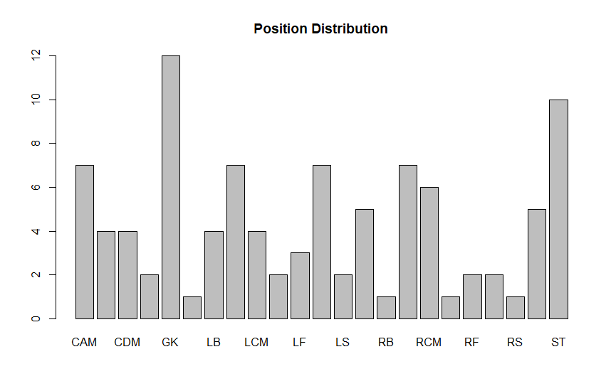

Slide 13
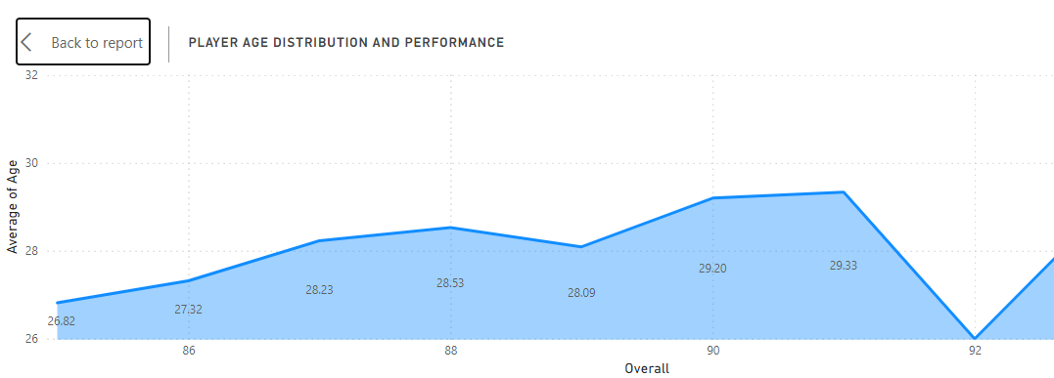

Slide 14
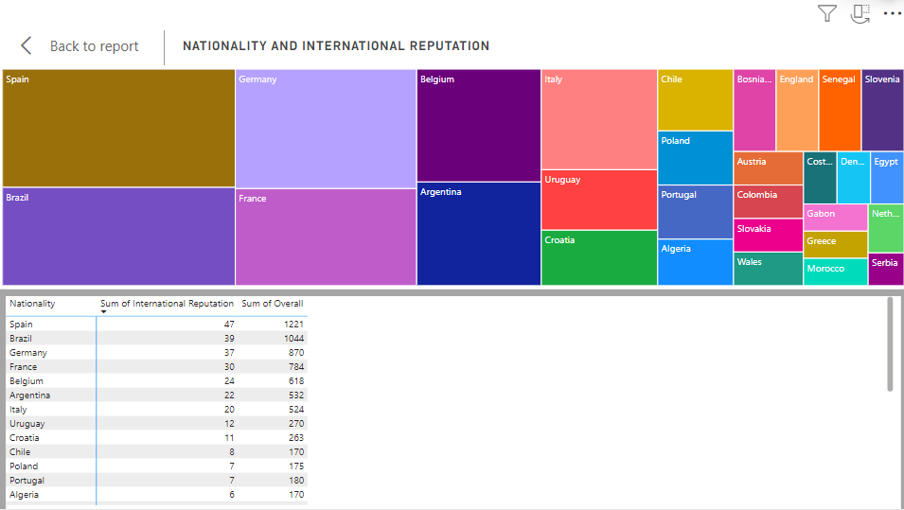

Slide 15
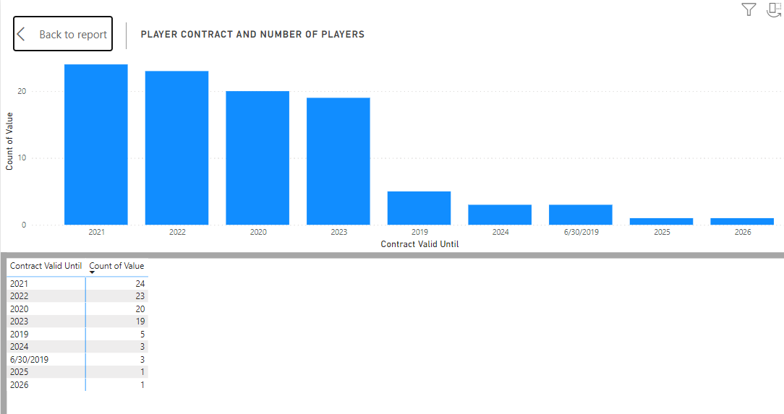

Slide 16
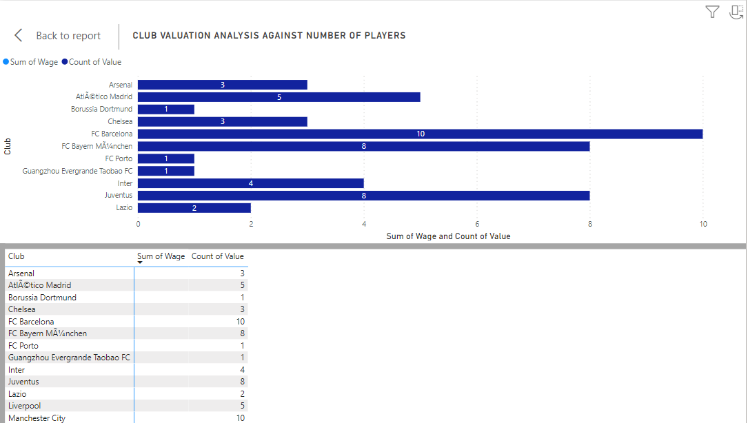

Slide 17
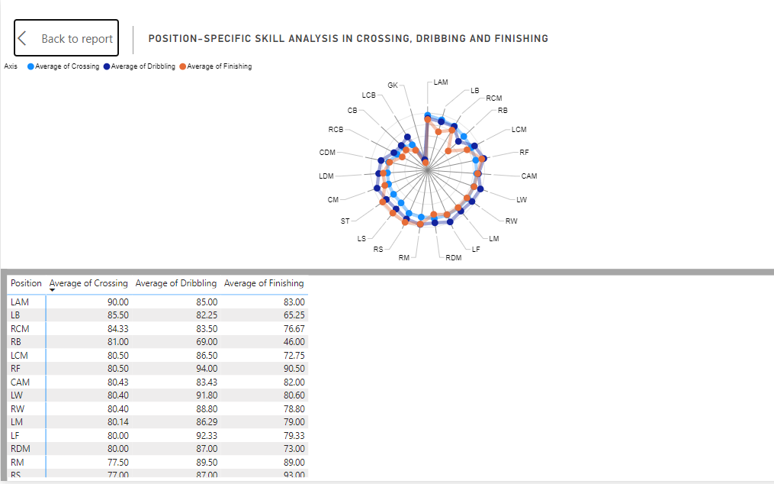

Slide 18
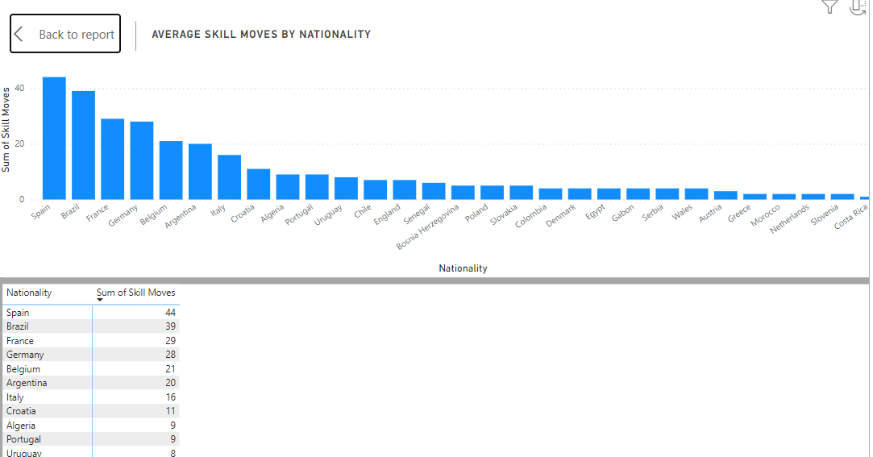

Slide 19
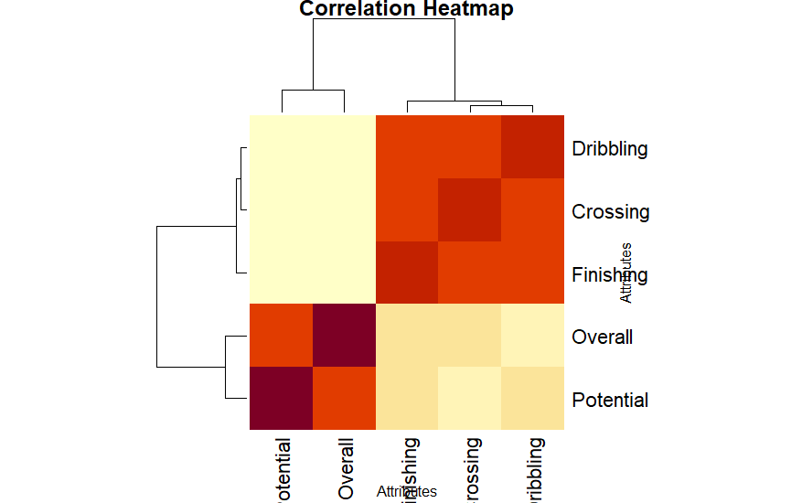

Slide 20
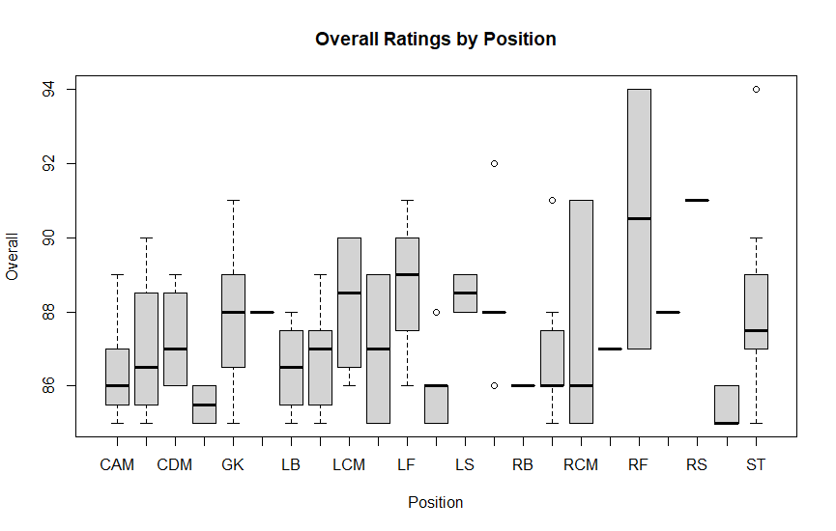

Slide 21
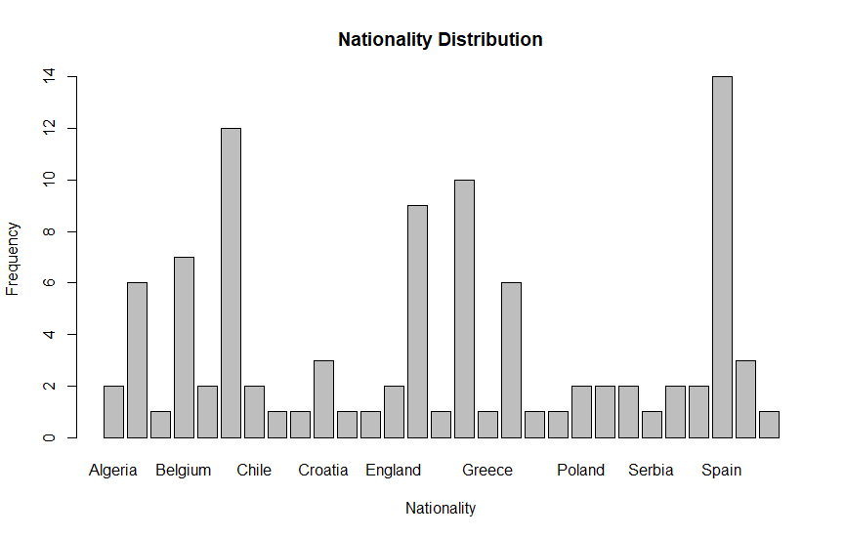

Slide 22
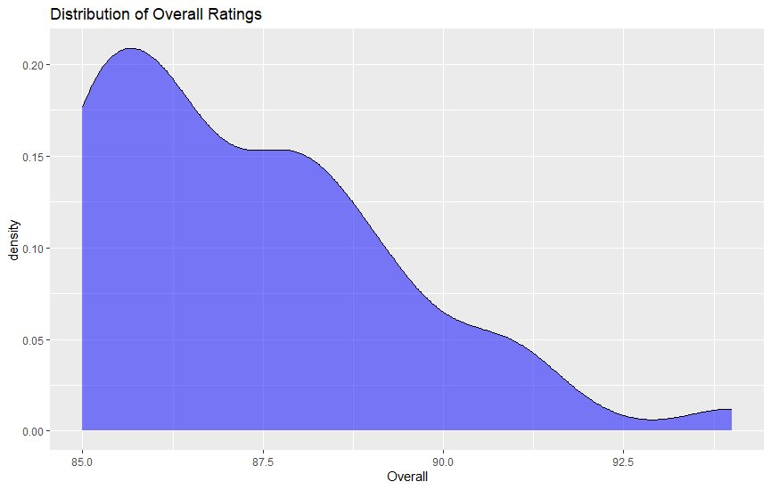

Slide 23
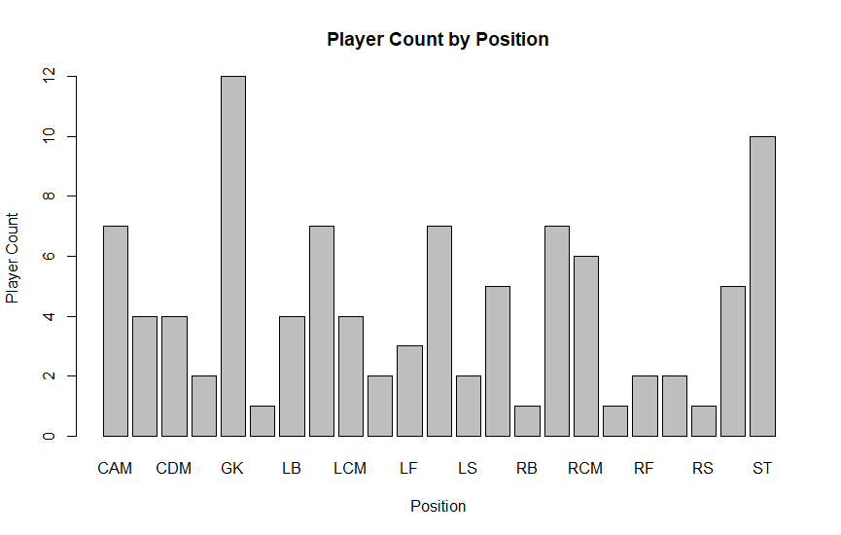

Slide 24
Benefits of
Sports
Analytics
  Informed Decision-Making
  Increased Revenue
  Enhanced Performance
  Talent Scouting
  Risk Management
  Fan Engagement
  Operational Efficiency

Slide 25
What do sports analytics do
Sports analytics involves the application of data, statistical models, and computer algorithms to evaluate and optimize performance in athletics. It encompasses various forms of data analysis, ranging from simple statistics like player averages and game outcomes to complex machine learning models predicting player injuries or match results. Analytics can offer insights into player performance, tactical approaches, and even fan engagement, allowing coaches, managers, and organizations to make more informed decisions. Whether through tracking sensors, game footage, or historical data, analytics tools compile large sets of information to derive actionable intelligence.

Slide 26
In the context of sports, analytics serves multiple functions. On the field, coaches and analysts use data to assess player performance, inform tactical decisions, and devise game plans. For example, basketball coaches may use analytics to identify shooting hot spots of opponents, while soccer managers might use data to optimize player positions and strategies. Sports analytics also play a vital role in player health and wellness. By analyzing data from wearable devices and medical reports, teams can anticipate player injuries and manage workload, contributing to optimal athletic performance and extended career longevity.
How is sports analytics used in sports

Slide 27
What is sports analytics in business intelligence
In the realm of business intelligence, sports analytics contributes to optimizing various aspects of sports management and operations. From ticket sales and merchandise revenue to fan engagement and brand partnerships, analytics help organizations become more data-driven. By utilizing tools like customer segmentation, predictive modeling, and real-time dashboards, sports teams can create targeted marketing campaigns, enhance fan experiences, and improve operational efficiency. Essentially, business intelligence in sports analytics aims to provide a 360-degree view of an organization’s health and opportunities, thereby informing strategic business decisions.

Slide 28
How is analytics changing sports
Analytics is fundamentally changing the way sports are played, managed, and consumed. Advanced statistical models and real-time data are making teams more strategic and informed, challenging traditional approaches to coaching and game planning. Analytics has also ushered in new metrics that provide deeper insights into player performance and team dynamics, often redefining what skills and strategies are valued. Additionally, analytics is influencing fan engagement by personalizing experiences through tailored marketing campaigns and interactive, data-driven applications. Overall, the incorporation of analytics is making sports more precise, more engaging, and increasingly oriented around data-based decisions.

Slide 29
The future of sports analytics is poised for expansion in both depth and scope. With advances in technology, like AI and machine learning, increasingly complex questions will be answerable. For instance, we can expect predictive models to become more accurate, opening doors to dynamic, real-time coaching adjustments during games. On the business side, integration of big data and analytics will continue to enhance fan personalization, sponsorship valuation, and operational efficiency. Furthermore, as data collection becomes more sophisticated, ethical considerations concerning data privacy and usage will become paramount. In sum, sports analytics is expected to become more integrated, more advanced, and more essential in shaping the future of sports.
What is the future of sports analytics

Slide 30
Thank You

